Slide 1
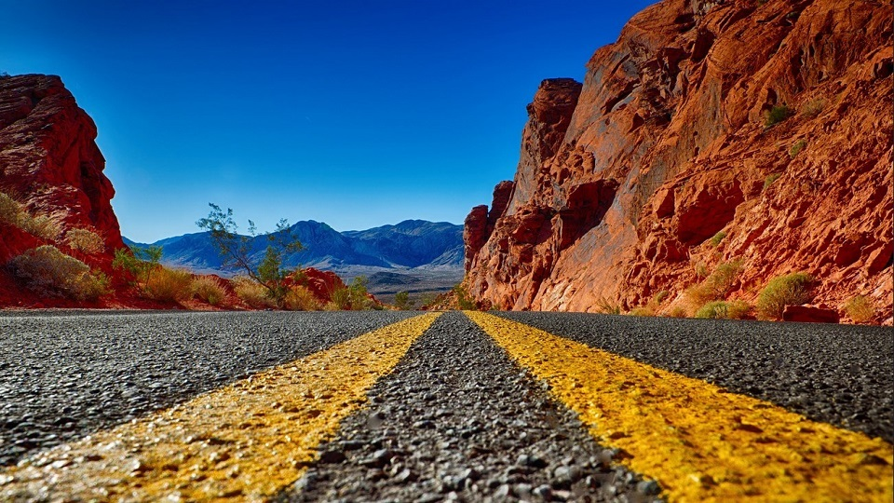
Accident detection
Road and Transport Ministry
Nivish Sharma Pranisha Sharma Poorvanshu Gupta Chetan Gaur

Slide 2
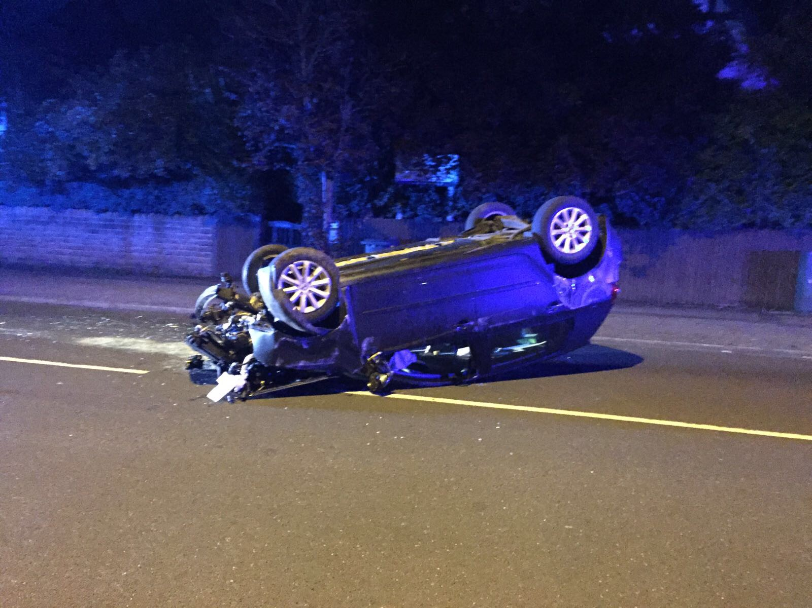
Imagine
You are travelling in your car, with your loved ones. Its dark and cold outside and you lose control of the car due to lack of sleep.
The car veers off, hits a tree and turns over.
There is a CCTV camera on that road but
WHAT ARE THE ODDS THAT SOMEONE IS MONITORING THAT CAMERA?
Our system uses machine vision and artificial learning and can report such an incident to emergency services automatically.

Slide 3
Beware violators of traffic rules! CCTV cameras installed at several important locations of the city are keeping a hawk’s eye on you.
…Says a snap from Jaipur traffic police website.
Beijing '100 Percent Covered' by Web of Surveillance Cameras
…Says a Chinese website
Similarly, there are an estimated 5,00,000 security cameras monitoring greater London area and AAP government manifesto promised to install 15,00,000 security cameras in Delhi alone.

Slide 4
More cameras are going unmonitored
Control rooms have limited eyes on screens and in most cases only post dated video retrieval is possible from the installed cameras.

Slide 5
What if ???
A computer could be given the job of watching thousands of cameras day in and day out?
Currently computers can record and store the video data but artificial intelligence is an emerging frontier that can let computers actually ‘see’ and understand images like humans.
We have used the concept of machine vision to detect incidents that might warrant human attention.
The system can be expanded to report locations and visuals of any incident to police and emergency services automatically-without human involvement of any sort.

Slide 6
Existing CCTV networks are compatible
No need to upgrade the cameras or install new ones
Can currently detect the following in addition to a lot more
  Shattered glass
  Leaking fuel from totalled cars
  Spilled blood
  Bodies lying motion less in crashed cars
  Crashed cars
  Upturned cars
  Burning cars

Slide 7
This system can save lives
This is a comparatively cheap, indigenously developed piece of software that can save lives.
India has a ‘Bystander problem’. People hesitate in reporting accidents and crimes to police and that is where this system can come in.
This system can lead to timely dispatch of emergency services.

Slide 8
How did we make it?
We used the concept of ‘DEEP LEARNING’ in artificial intelligence to train our model.
We painstakingly collected data on accidents and classified them into two parts
Training data
Validation data

Slide 9
Then, we let the computer train itself
The training time lasted a night give or take.
The computer and its GPU had to be cooled externally due to extreme processing load for extended period.
By morning, the trained AI model had looked at images millions of times and learned to distinguish between a totalled car and an intact car.
It could detect spilled blood, shattered glass, overturned cars, burning vehicles and a lot more.
But this is just the starting. This model can be further trained to detect with superhuman accuracy and speed.
The current accuracy stands at a staggering 86%. The processing times are also very low.

